Slide 1


Data Analysis Techniques 890F3
ER KC JE
Probability Essentials

Slide 2
Welcome New People
Module Notes: https://dorksquith.github.io/DataAnalysisTechniques/
Read the front page and follow the technical guidance
All the notes for part 1 are at this link along with python examples.
Expect frequent updates
Canvas: https://canvas.sussex.ac.uk/courses/39055
Read the Module Information and Assessments & Guidance pages
Watch the Intro lecture under Introduction & Resources-> Welcome and Introduction
Watch the week 1 lecture under 1. Terminology and Concepts

Slide 3
Last week’s Tasks
Week 1 tasks for you:
Take the time to decide if this is the right module for you by reviewing the jupyter book notes available
Work through Terminology & Concepts
Do a first read of Probability Essentials before we meet on Monday
In the Workshop we identified some issues with people not having access to a Terminal. Please see the updated instructions https://dorksquith.github.io/DataAnalysisTechniques/
It is essential that you can execute markdown files as a jupyter book, as this will be the format for all your assessed submissions.
The first coursework task is due week 4 and will be released this week prior to the workshop.

Slide 4
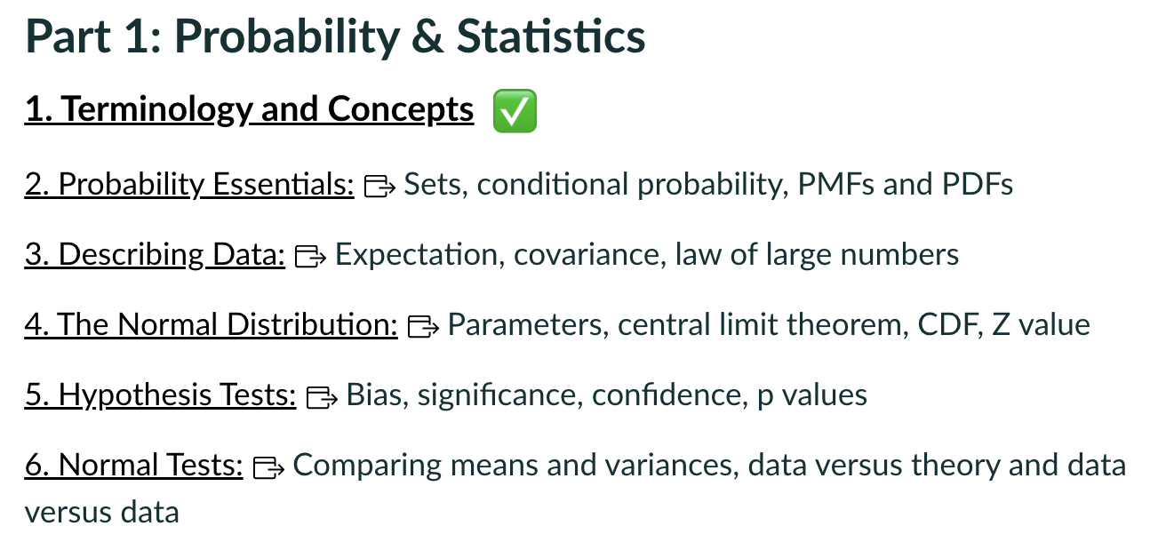
Where we are
Broad & Shallow intro to things we will keep revisiting
Today

Slide 5
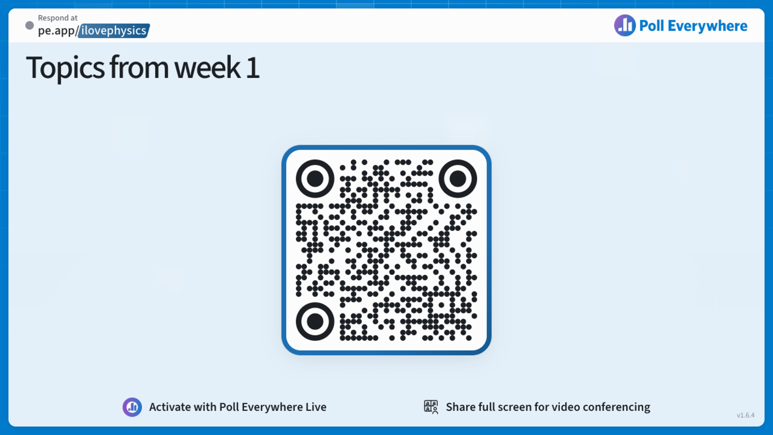

Slide 6
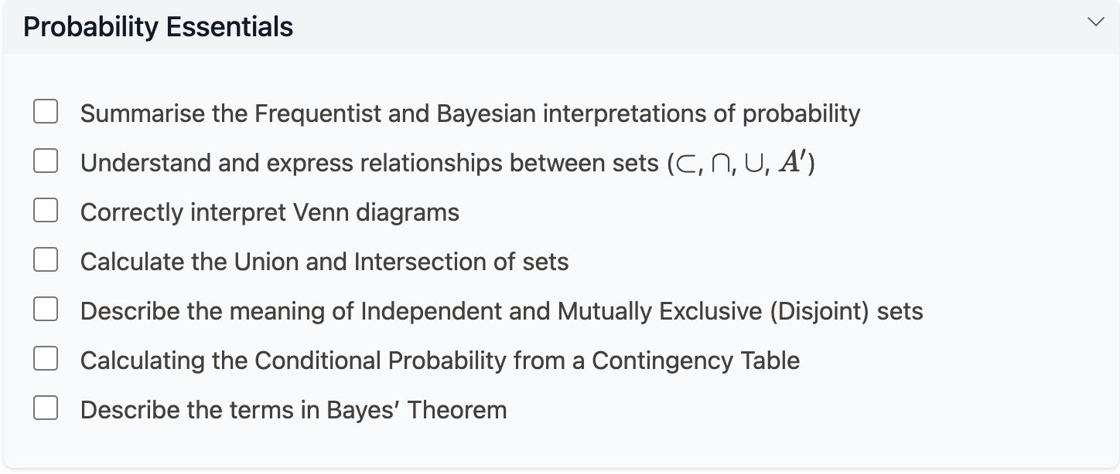
Probability Essentials

Slide 7
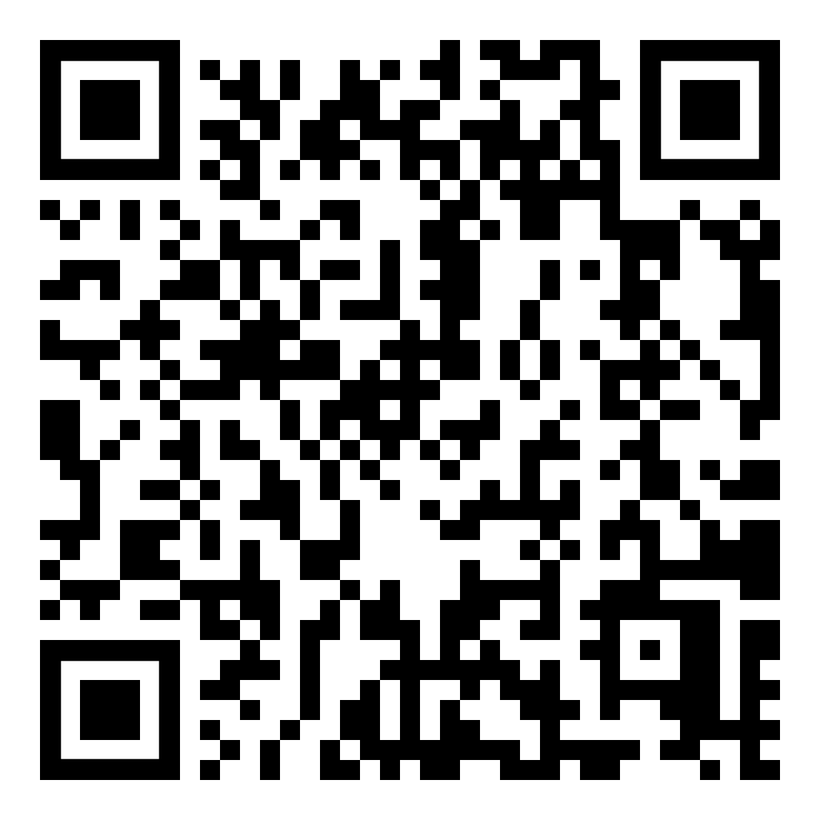
Probability Essentials: let’s go to the notes
https://dorksquith.github.io/DataAnalysisTechniques/probabilityessentials/
Focus:
Conditional and Total Probability
Distributions and Normalisation
Extra:
The Monty Hall Problem

Slide 8
Focus 1/2:
Conditional and Total Probability
(& Bayes’ Theorem)

Slide 9
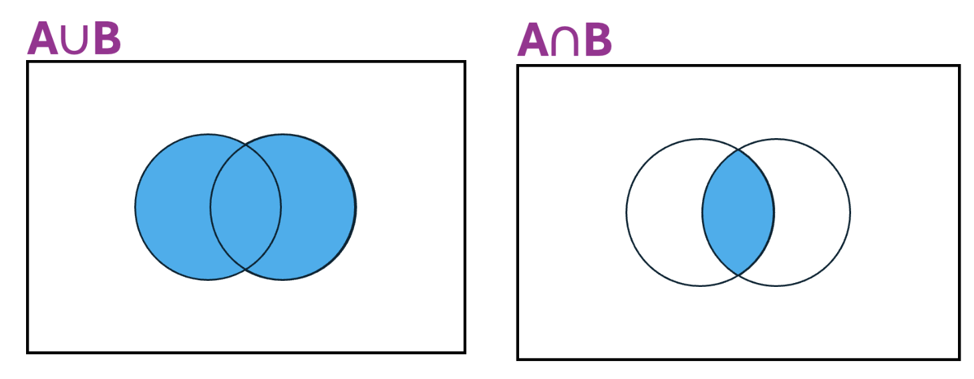
Notation
Union: (A) or (B) or (Both A and B)
Intersection: (Both A and B)

Slide 10
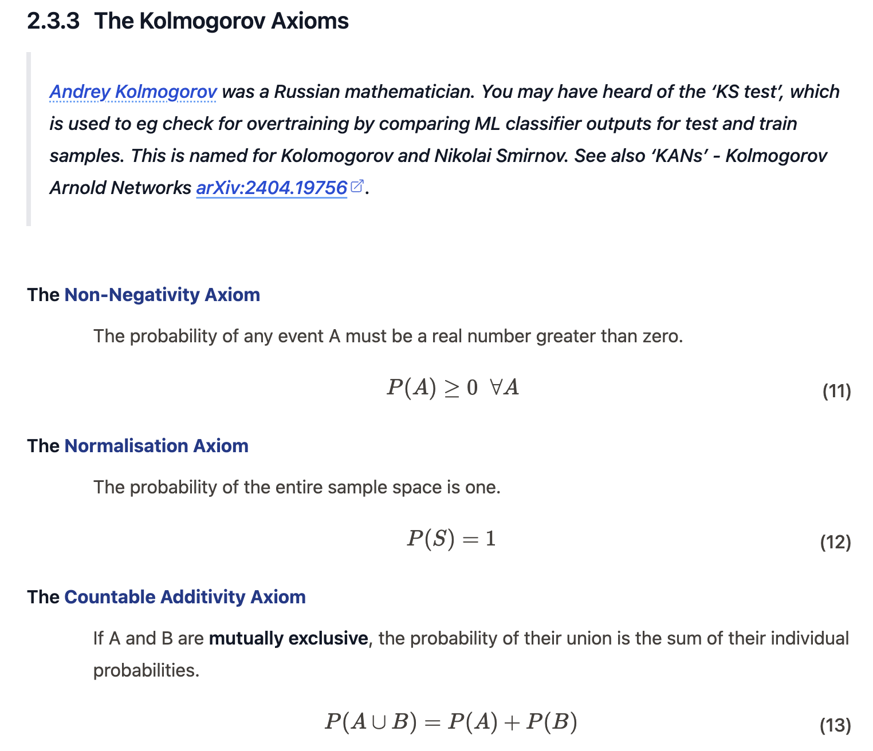

Fundamental
Things can get complicated, so we must always check Kolmogorov 2 is satisfied
means “for all A”

Slide 11
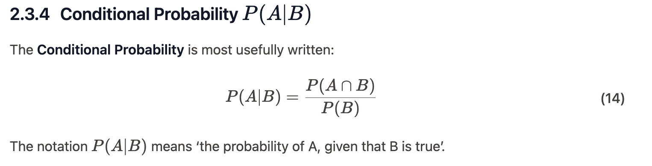
Conditional Probability
Joint Probability of A and B: “the probability that both A and B are true”
Total Probability of B

Slide 12
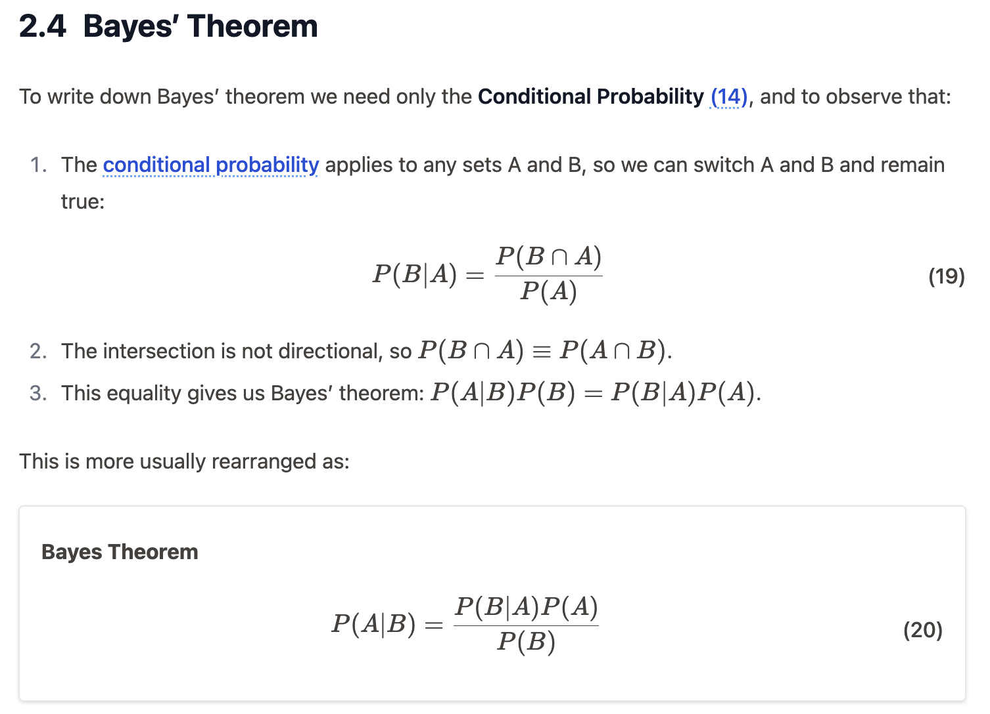
Bayes
Conditional = Joint / Total
Bayes’ Theorem only has Conditionals and Totals

Slide 13
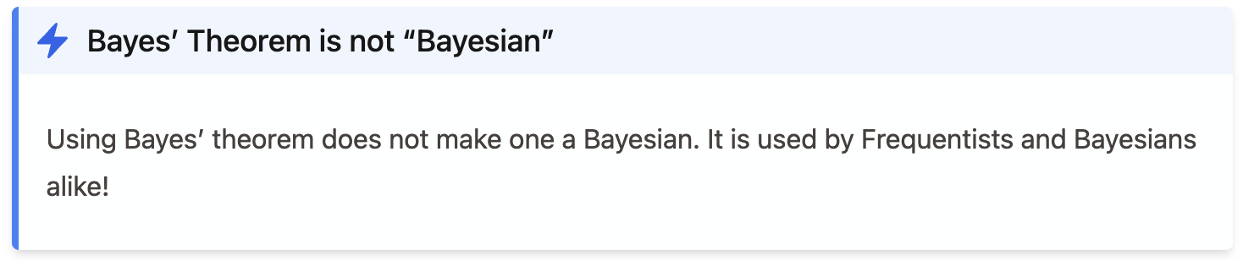
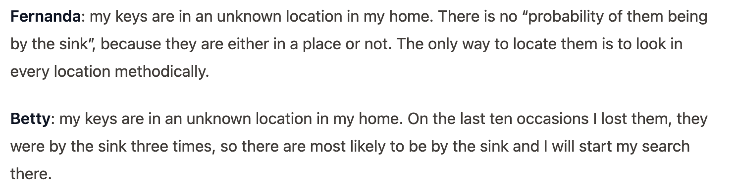
Bayes Theorem does not a Bayesian make
A Bayesian uses Prior Knowledge in their probability calculation.
Frequentist
Bayesian

Slide 14
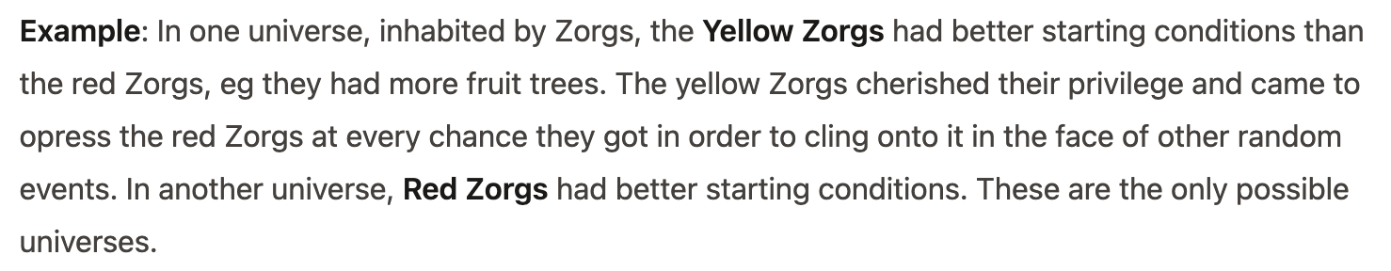
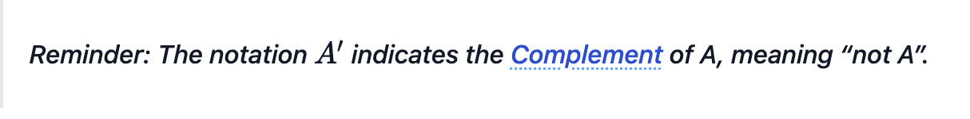
Y
Y’

Slide 15
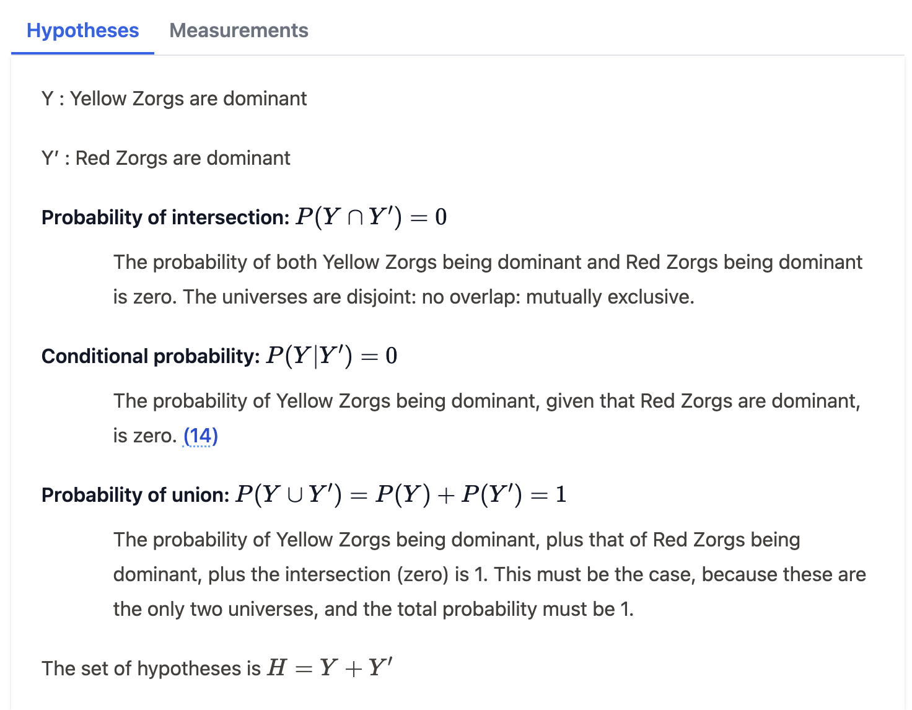
Upper case letters for the universe: Y or Y’
Intersection symbol looks like n: means “and”
This is the Joint Probability of Y being true and Y being false
Because Conditional = Joint / Total, and Joint = 0
Probability of Y being true or false is 1.

Slide 16
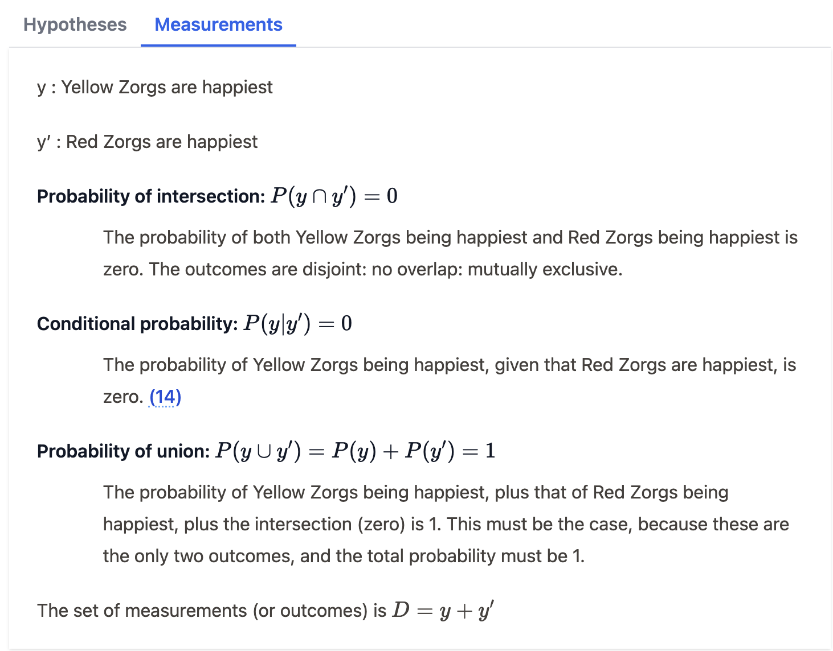
Lower case letters for the data: y or y’

Slide 17
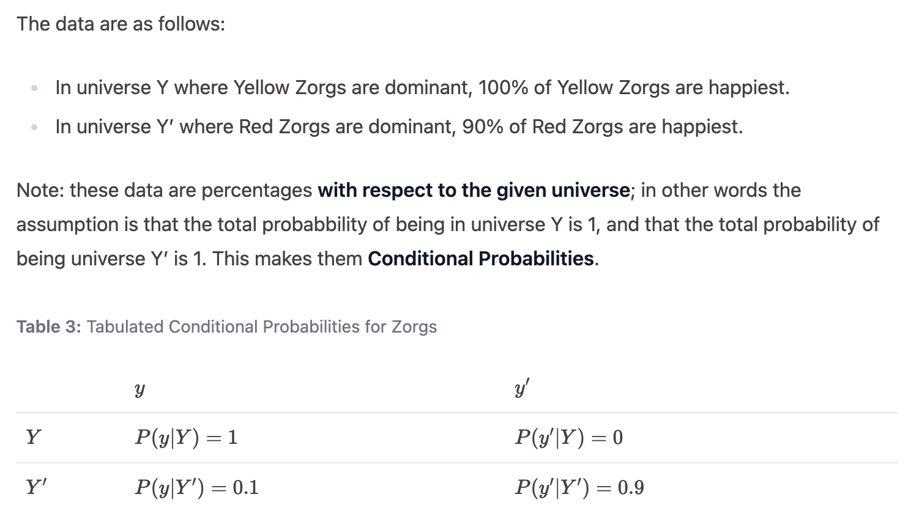
Data: Zorg Happiness

Slide 18
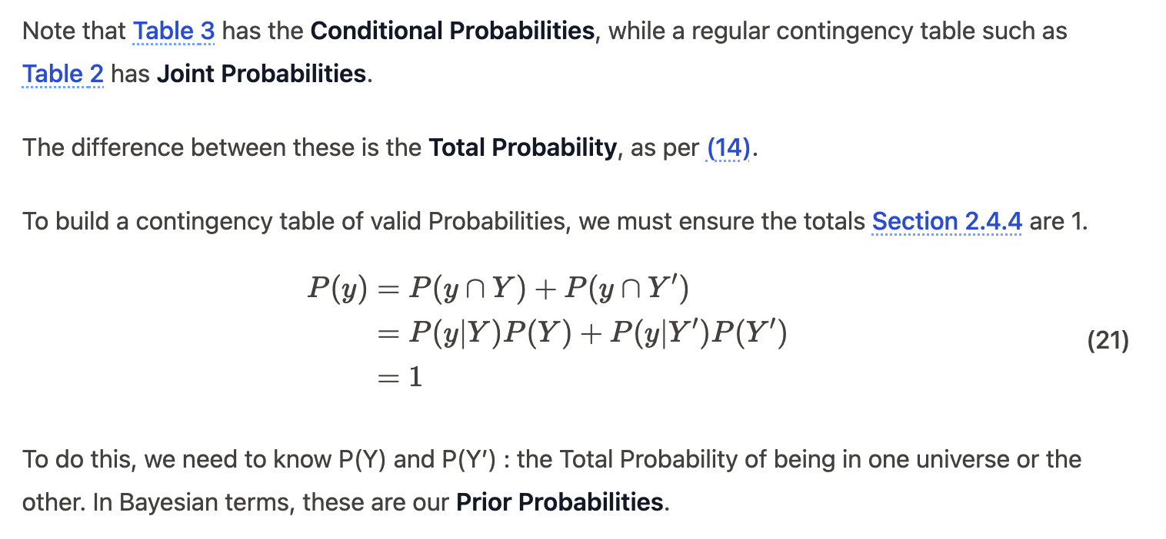
The Total Probability of the Data, P(y)

Slide 19
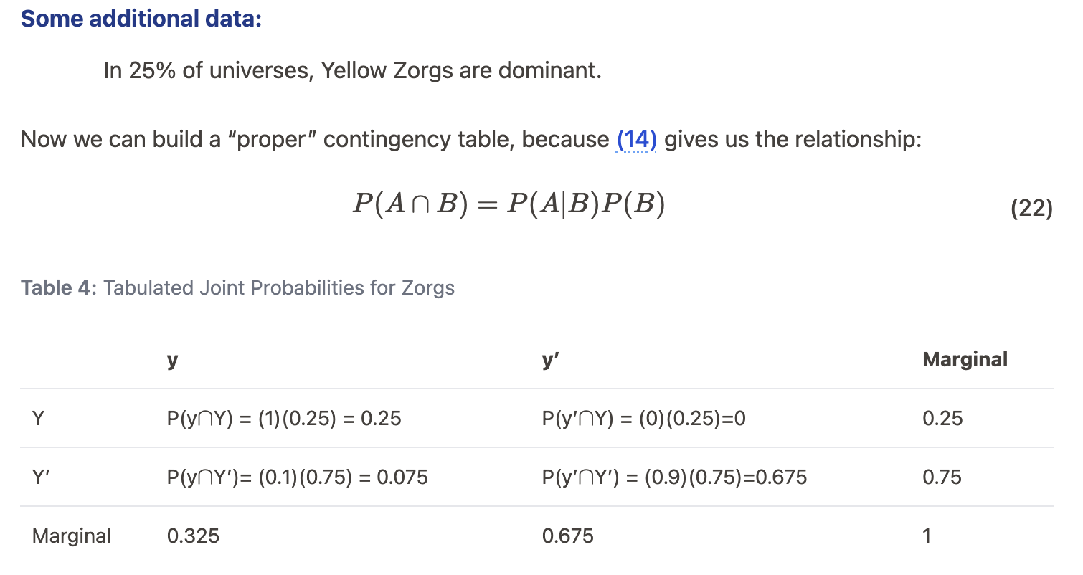
Joint = Conditional x Total

Slide 20
Focus 2/2:
Distributions and Normalisation

Slide 21
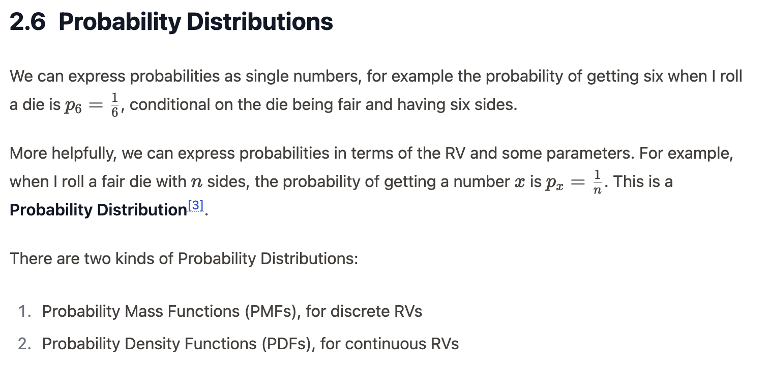
This is a PMF

Slide 22
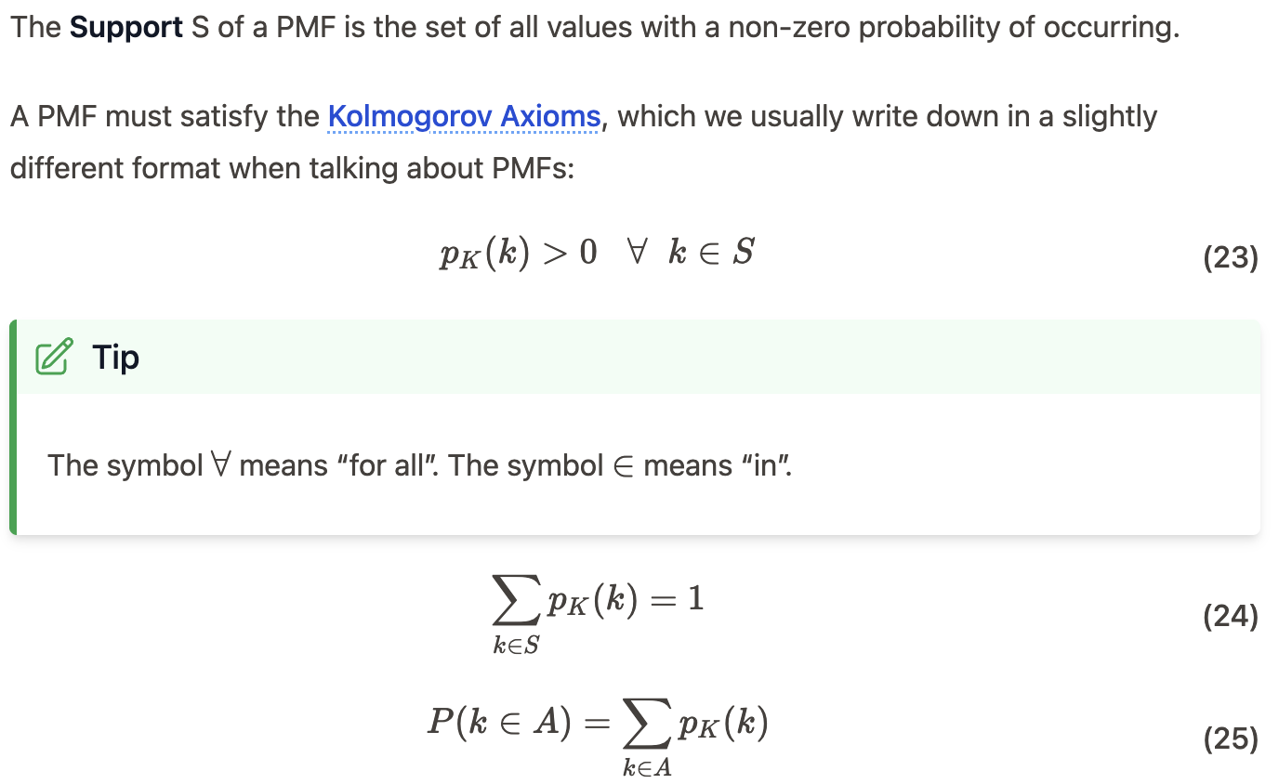

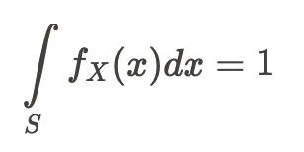
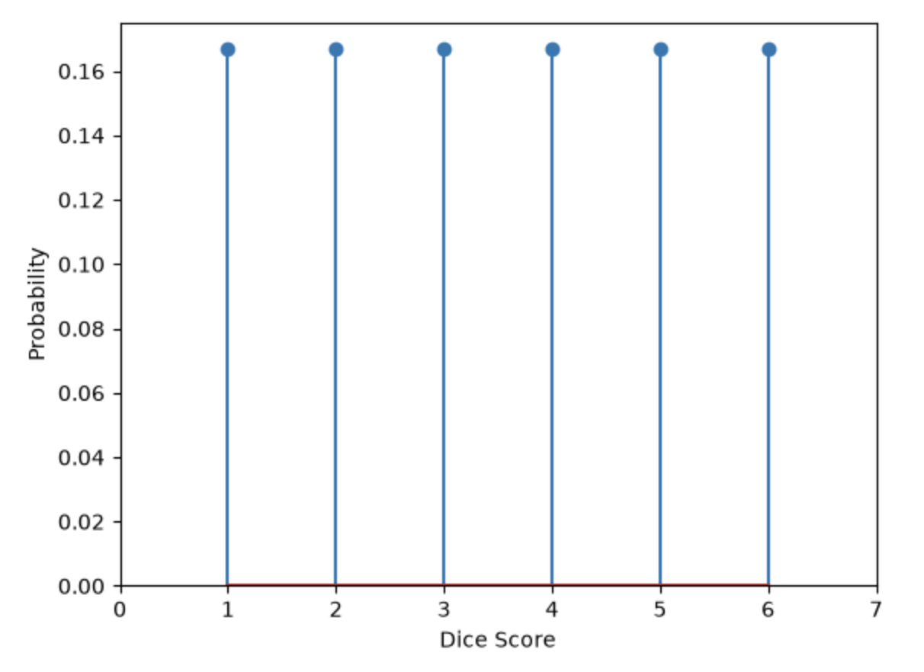
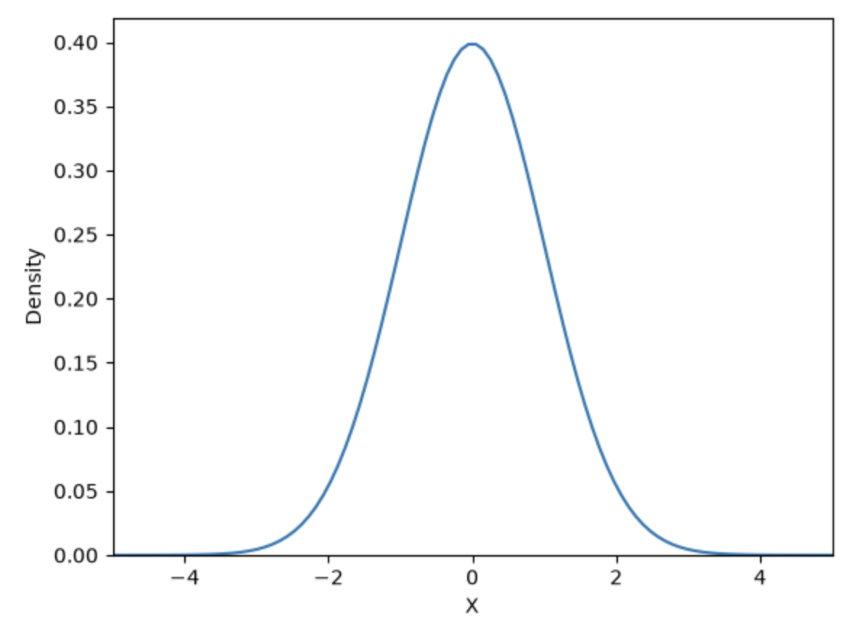
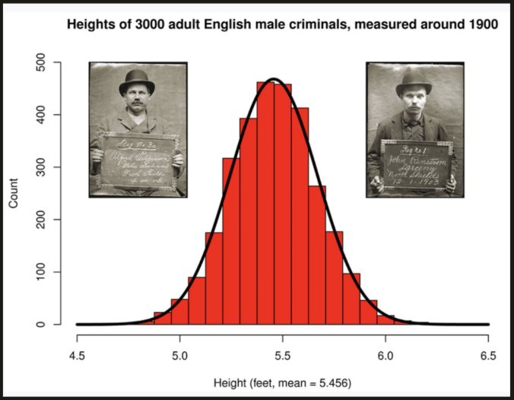
PMFs
PDFs
x-axis: Discrete RV values k
y-axis: PMF = probability of k
x-axis: Continuous RV values x
y-axis: PDF = density of x

Slide 23
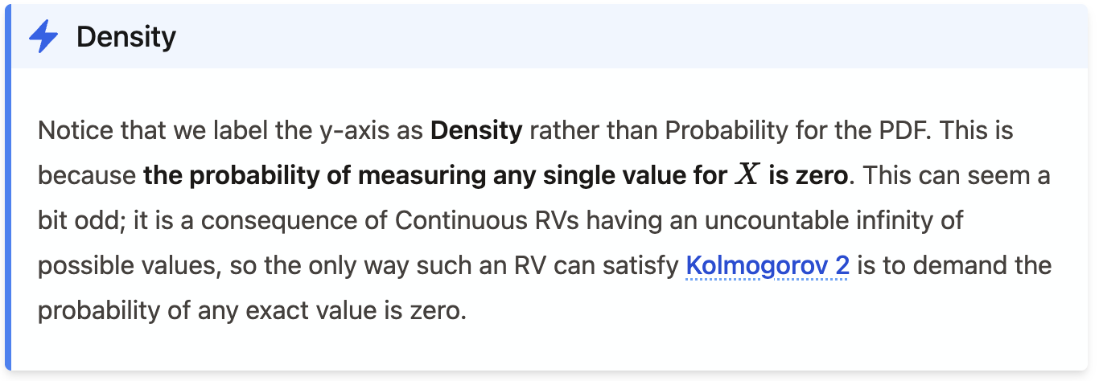
PDFs
For a continuous RV, we find the probability for a range of values from the area under the distribution (CDF).

Slide 24
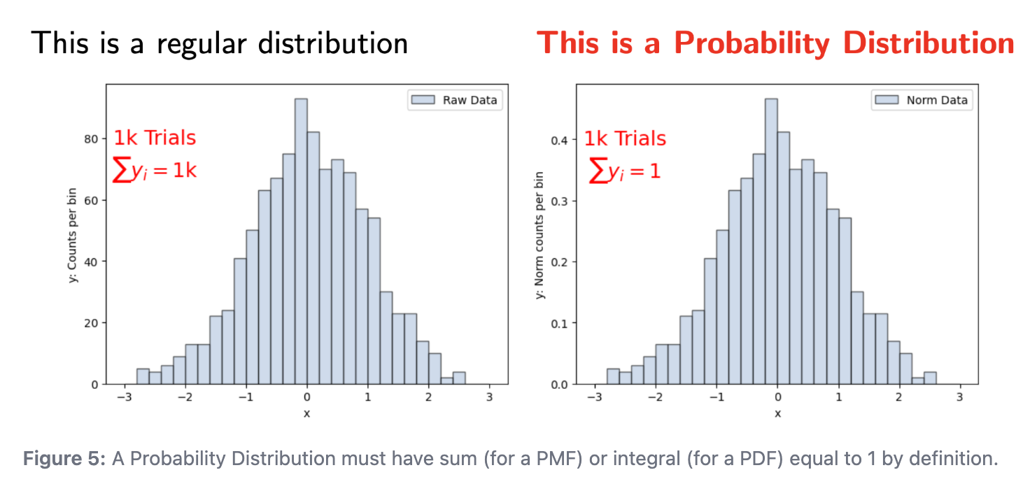
If sum or integral is not 1, it is not a probability distribution

Slide 25
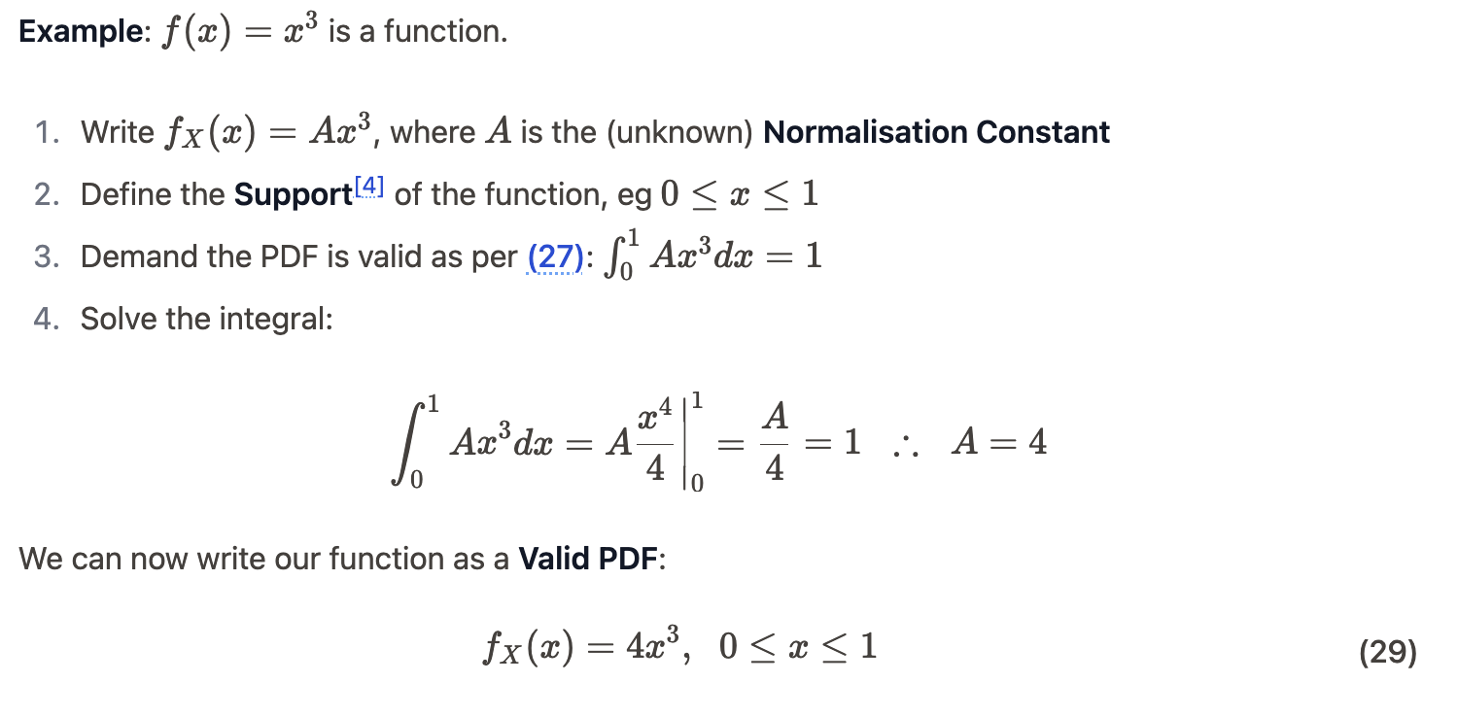
Normalisation
Normalisation means scaling a function to area 1. Sometimes here “Normalised to unity” but more often just “Normalised”.

Slide 26
3pm Lecture starts here!

Slide 27
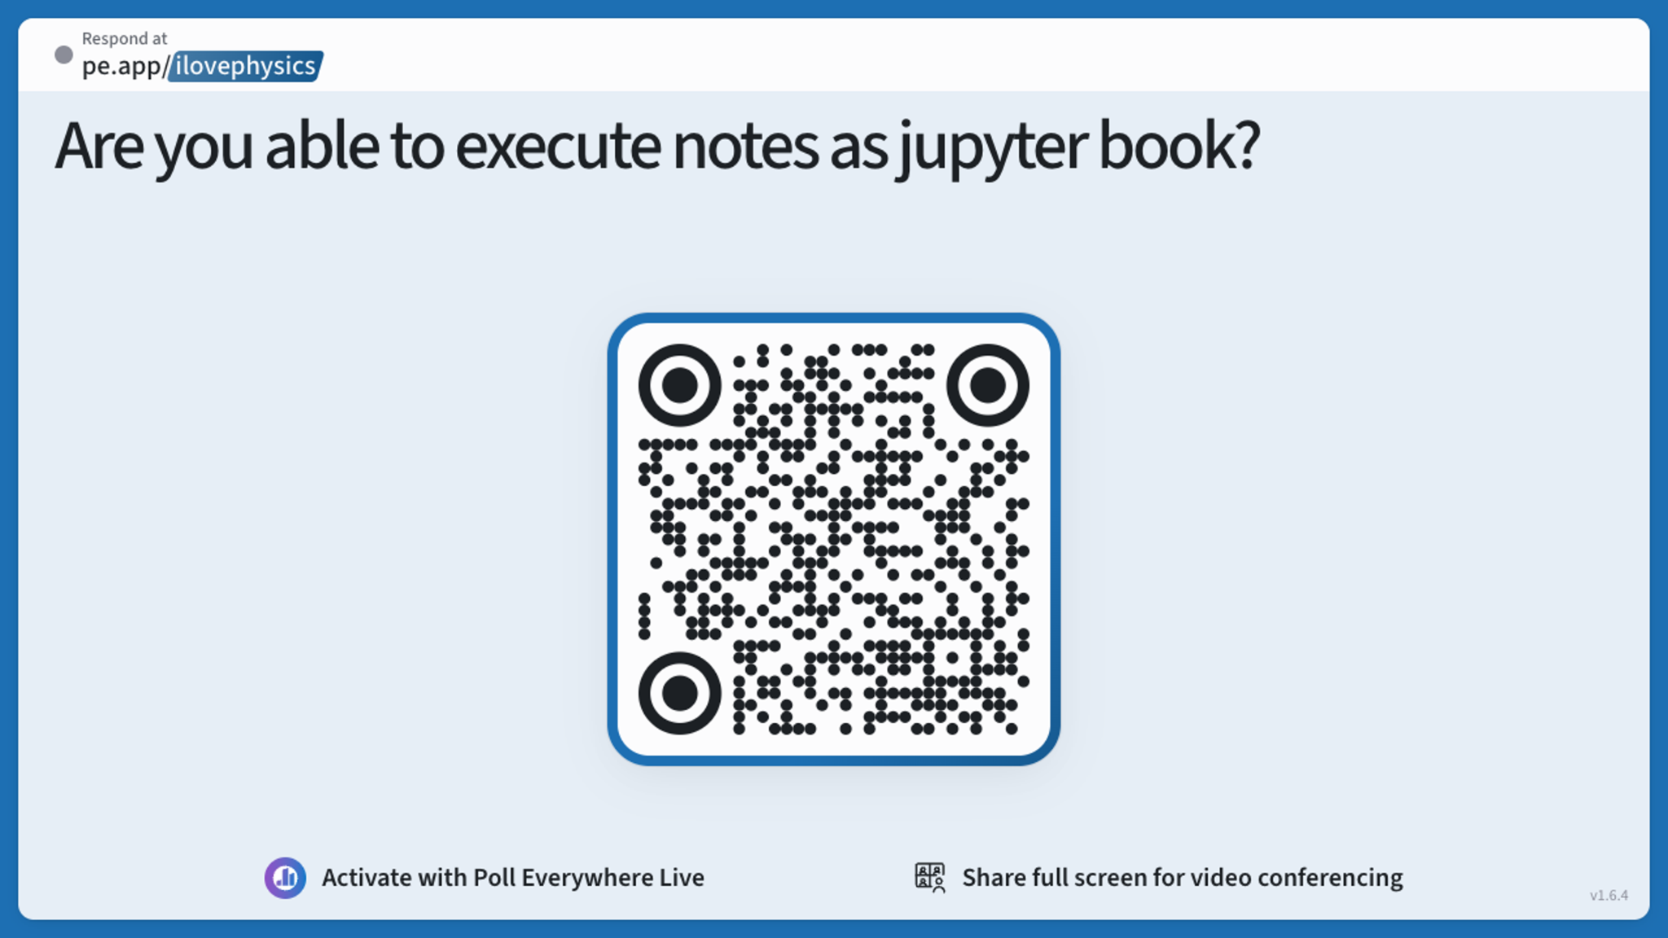

Slide 28
Questions while I ran to lunchtime meeting
Will there be an exam?
No. 70% software exercise, 30% best ⅔ coursework grades.
What really no kind of exam at all?
That’s right. An AI or your mate could theoretically do all the work towards your grade. I inherited this situation. My goal is to try to make the actual material useful to you.
Do not have an AI or a mate do the work for you for this module. That would be plagiarism and is strictly against university guidelines.

Slide 29
Questions while I ran to lunchtime meeting
What will be the exact format of the coursework?
You will find out the exact format of the coursework when it is released Wednesday. They will all be the same format, with submission via canvas.
You said there will be canvas quizzes with multiple choice
That is still my plan, in an effort to go some way to addressing the issue of not knowing who did the work students submit. But for the first coursework, we will not have this.
When will office hour be?
Currently Tuesdays 12-1. Placeholder because of non-triviality of finding slots.

Slide 30
Reminder
Module Notes: https://dorksquith.github.io/DataAnalysisTechniques/
Read the front page and follow the technical guidance
All the notes for part 1 are at this link along with python examples.
Expect frequent updates
Canvas: https://canvas.sussex.ac.uk/courses/39055
Read the Module Information and Assessments & Guidance pages
Watch the Intro lecture under Introduction & Resources-> Welcome and Introduction
Watch the week 1 lecture under 1. Terminology and Concepts
The same for 2. Probability Essentials

Slide 31
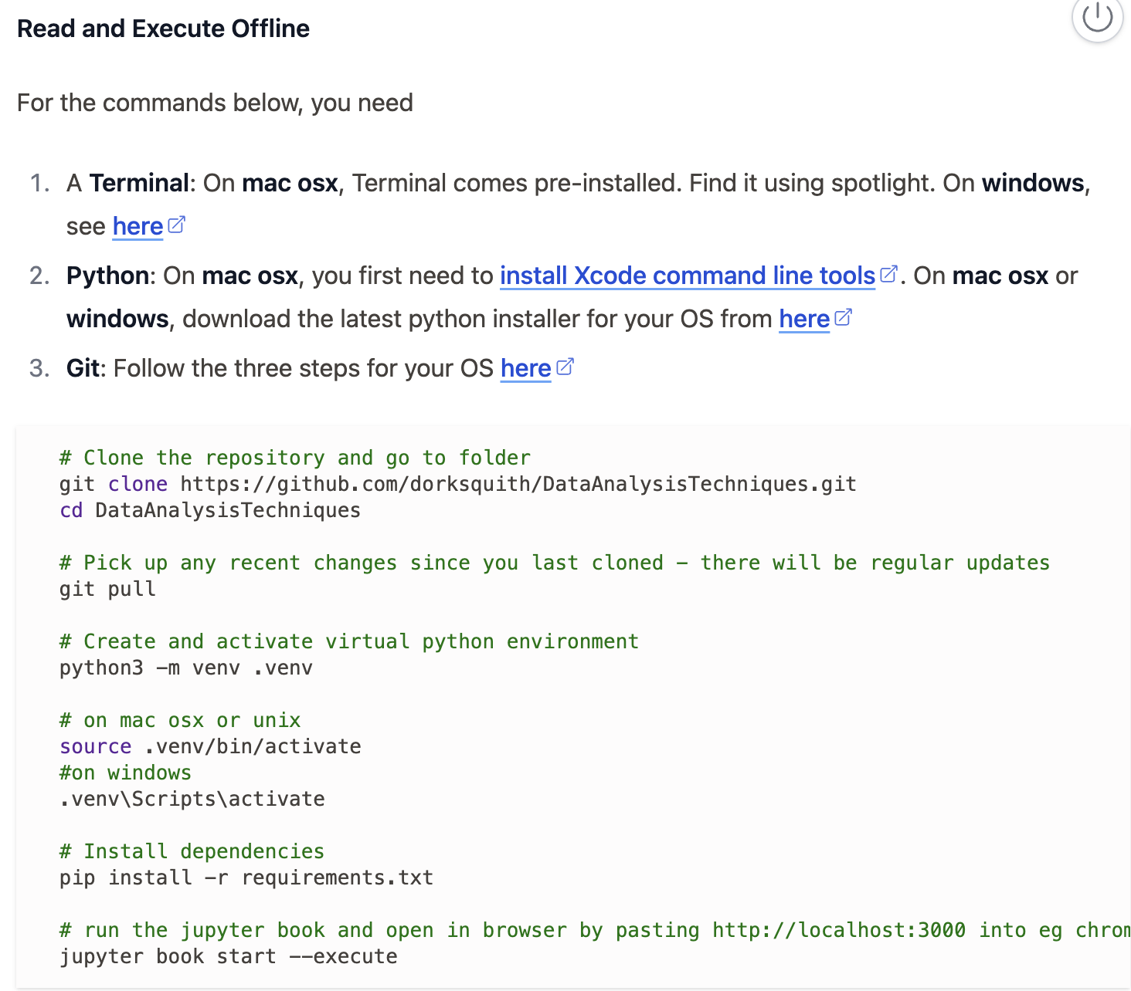
Most Important Thing
https://dorksquith.github.io/DataAnalysisTechniques/
Get this working for your operating system.
Making sure everyone is on top of this will be the main focus of Wednesday’s workshop.
It is essential for all your assessed work (3 courseworks and software exercise)

Slide 32
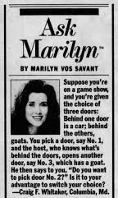

Extra: Monty Hall
Monty Hall was the host of the TV show
Marilyn Vos Savant solved the problem in her column

Slide 33
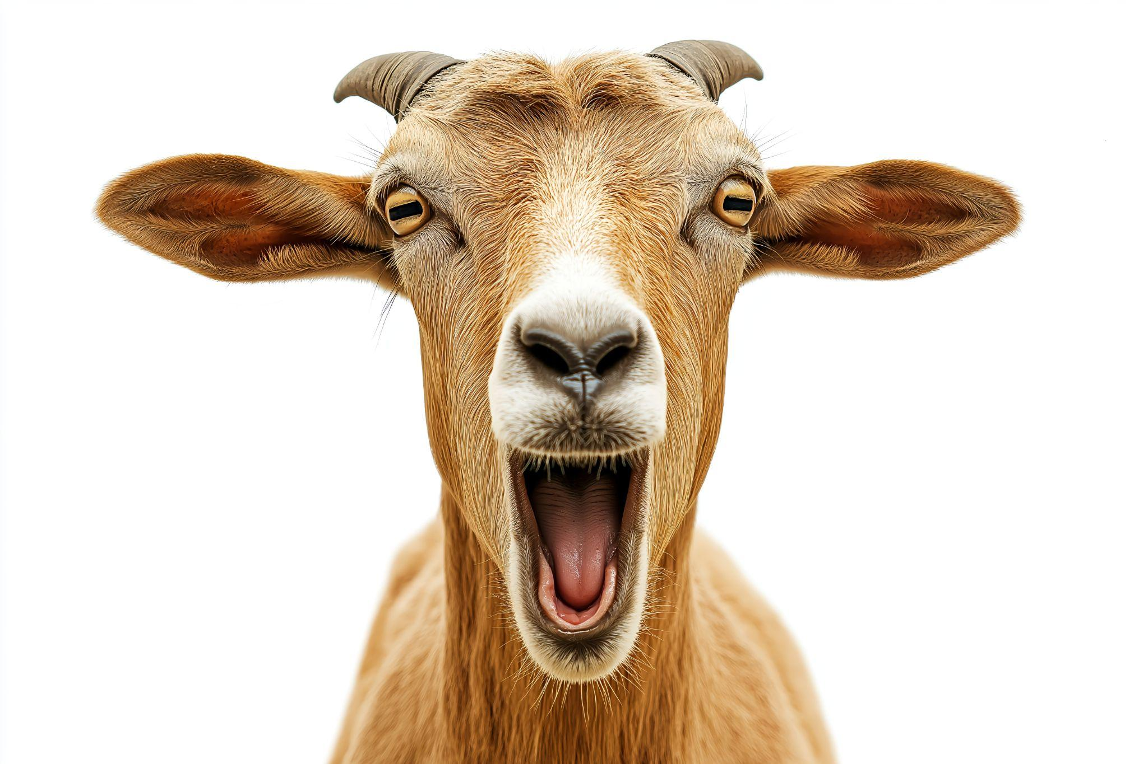

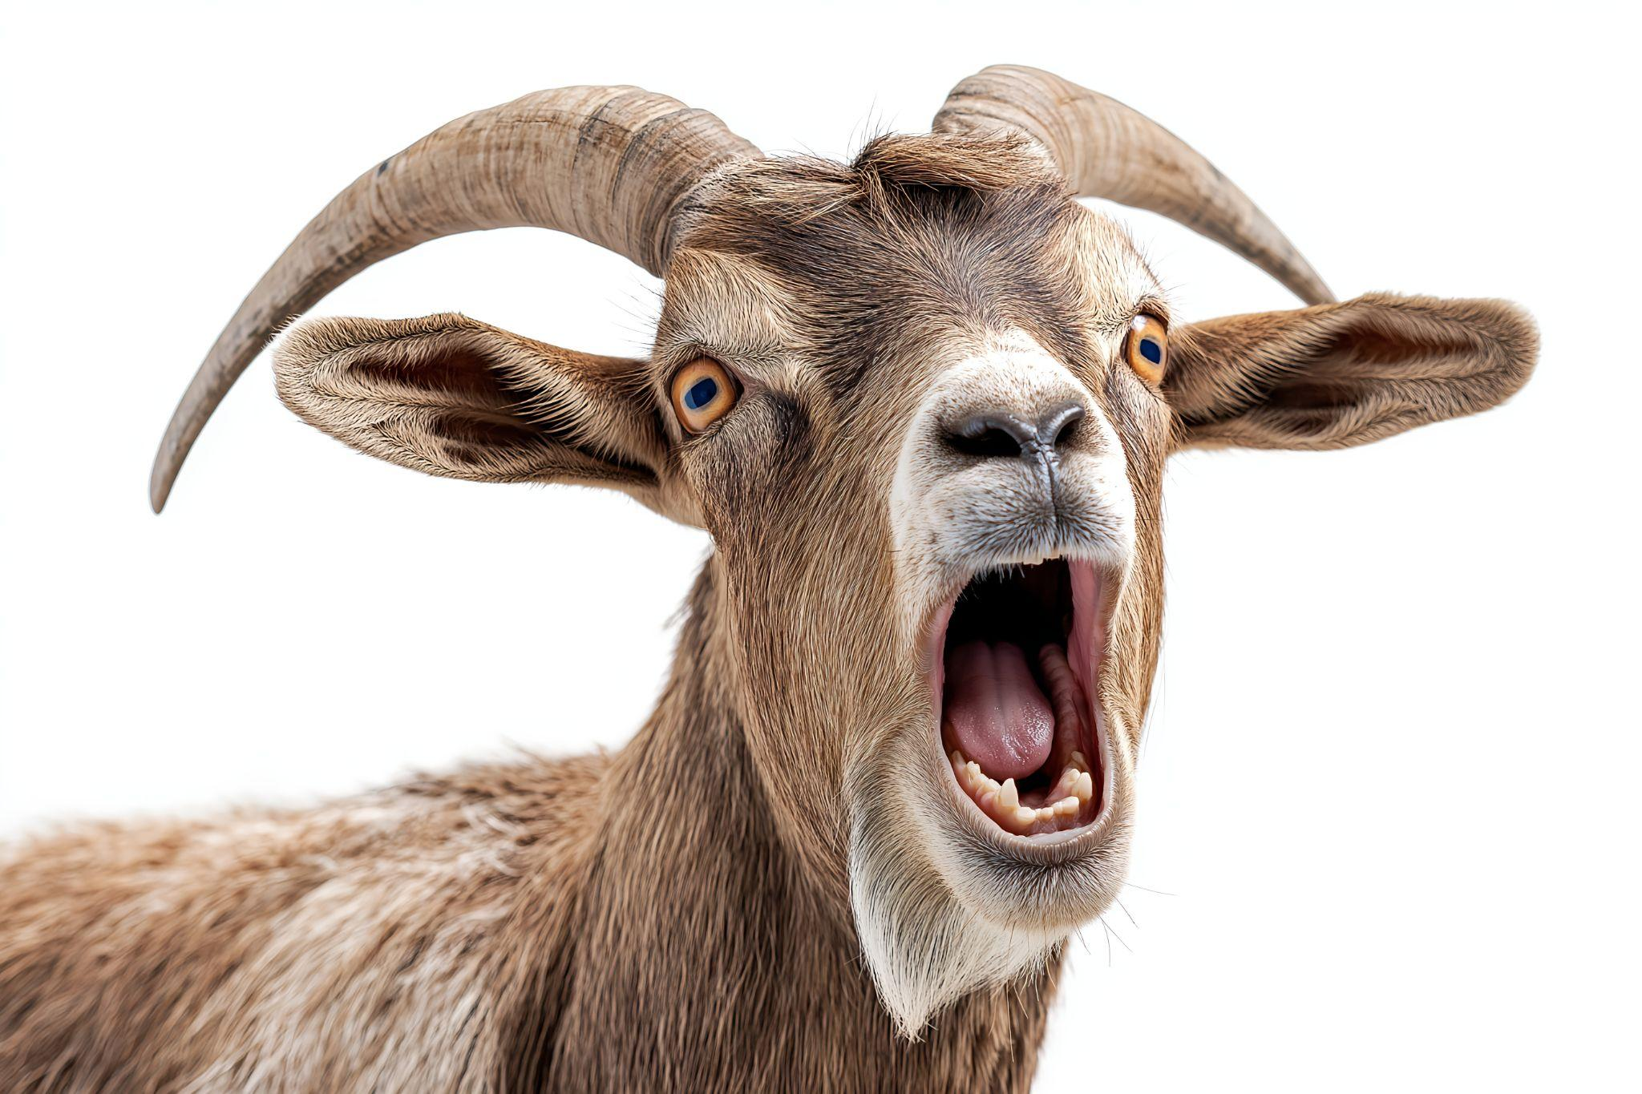
The Monty Hall Problem
Two angry goats and one fancy car

Slide 34



The Monty Hall Problem
Pick a door! Any door!

Slide 35
The Monty Hall Problem
This one please!

Slide 36

The Monty Hall Problem
Stick or switch?
Chosen door

Slide 37
The Monty Hall Problem
Better to switch!

Slide 38
The Monty Hall Problem P(Car) = ⅓ Uniform
p=1/3
p=1/3
p=1/3

Slide 39
Decision Tree
In three different “universes”, with each one a different choice
p=⅓
p=⅓
p=⅓
My choice: uniform odds

Slide 40
Decision Tree
p=⅓
p=⅓
p=⅓
My choice
p=1
p=1
p=½
p=½
Host’s choice: she knows where everything is, and will not pick the car - she wants it for herself!
If I chose badly, she has only one choice of door to open
If I chose well, she has two choices

Slide 41
Decision Tree
p=⅓
p=⅓
p=⅓
My choice
p=1
p=1
p=½
p=½
Host’s choice
Switch or stick ?
p=⅓
p=⅓
p=⅓
p=⅓
p=⅙
p=⅙
p=⅙
p=⅙

Slide 42
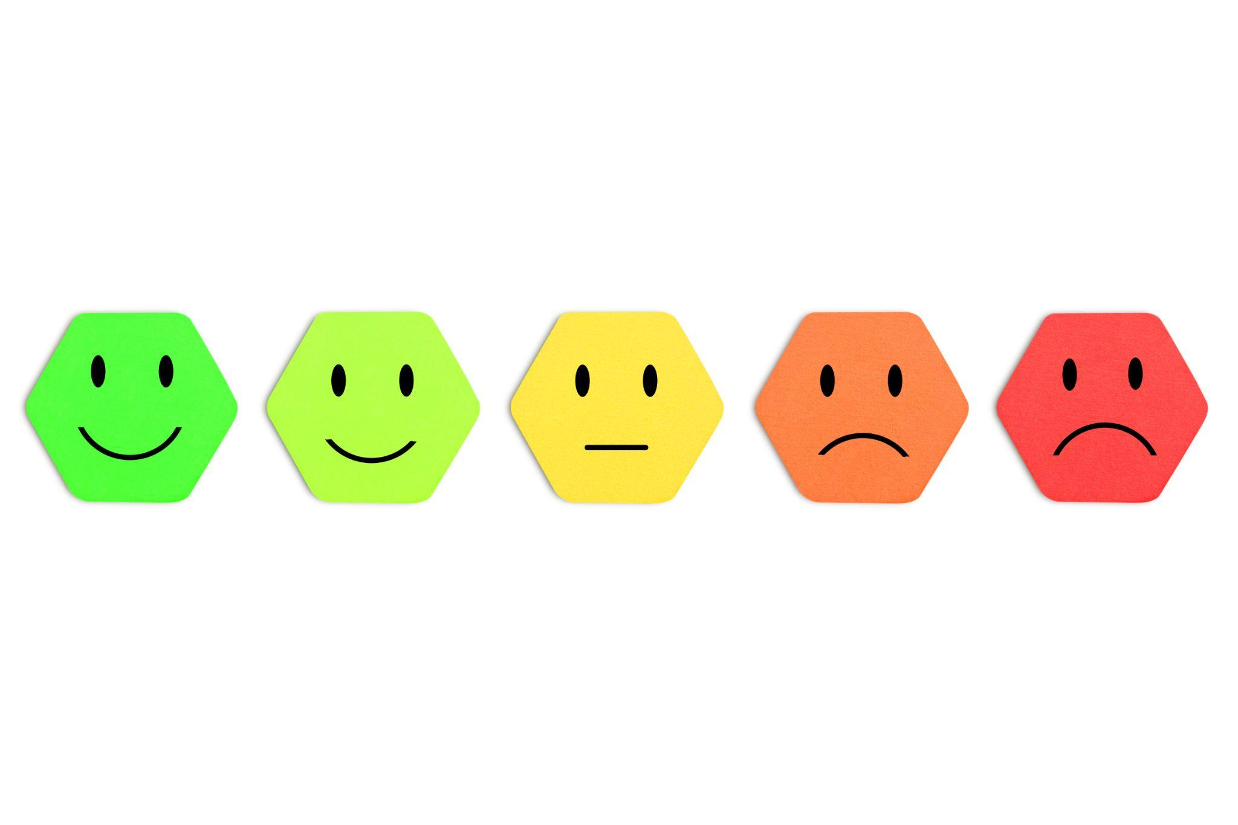
Switch Universe
p=⅓
p=⅓
p=⅓
My choice
p=1
p=1
p=½
p=½
Host’s choice
p=⅓ + ⅓ = ⅔
p=⅙ + ⅙ = ⅓
p=⅓
p=⅓
p=⅙
p=⅙

Slide 43
Stick Universe
p=⅓
p=⅓
p=⅓
My choice
p=1
p=1
p=½
p=½
Host’s choice
p=⅙ + ⅙ = ⅓
p=⅓ + ⅓ = ⅔
p=⅓
p=⅓
p=⅙
p=⅙

Slide 44
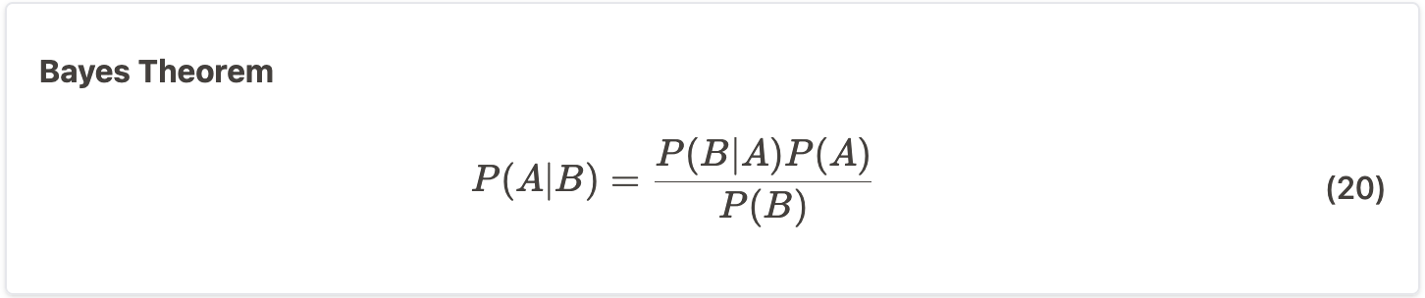
Bayes for Monty Hall
“Posterior Probability”
P(A|B) =?
Probability that I chose the car, given that the host showed me this goat
A: events where I chose the car
B: events where the host shows me this goat
|

Slide 45
Bayes for Monty Hall
P(B|A) = ½ there are two goats to choose from
Probability that the host will show me this goat, given that I chose the car.
A: events where I chose the car
B: events where the host shows me this goat
|

Slide 46
Bayes for Monty Hall
P(B|A) =½
P(A) =⅓ Initial frequentist probability of me choosing the car
Probability that I chose the car. Independent of anything the host does
A: events where I chose right first time
B: events where the host shows me this goat

Slide 47
Bayes for Monty Hall
P(B|A) =½
P(A) =⅓
P(B) =½ The host won’t show me the car, so it is not ⅓
Probability that the the host shows me this goat. Independent of my choice.
A: events where I chose right first time
B: events where the host shows me this goat

Slide 48
Bayes for Monty Hall
P(B|A) =½
P(A) =⅓
P(B) =½
P(A|B) = (½ )(⅓) / (½ ) = ⅓
The probability that I chose the car, given that the host showed me a goat.
If we played 3 times, switching would be the right choice in 2 of them

Slide 49
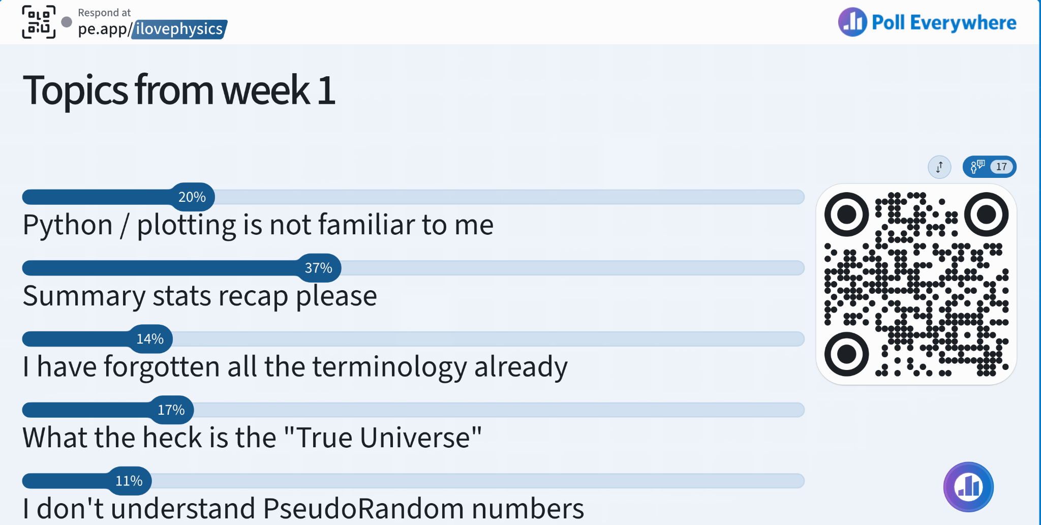

Slide 50
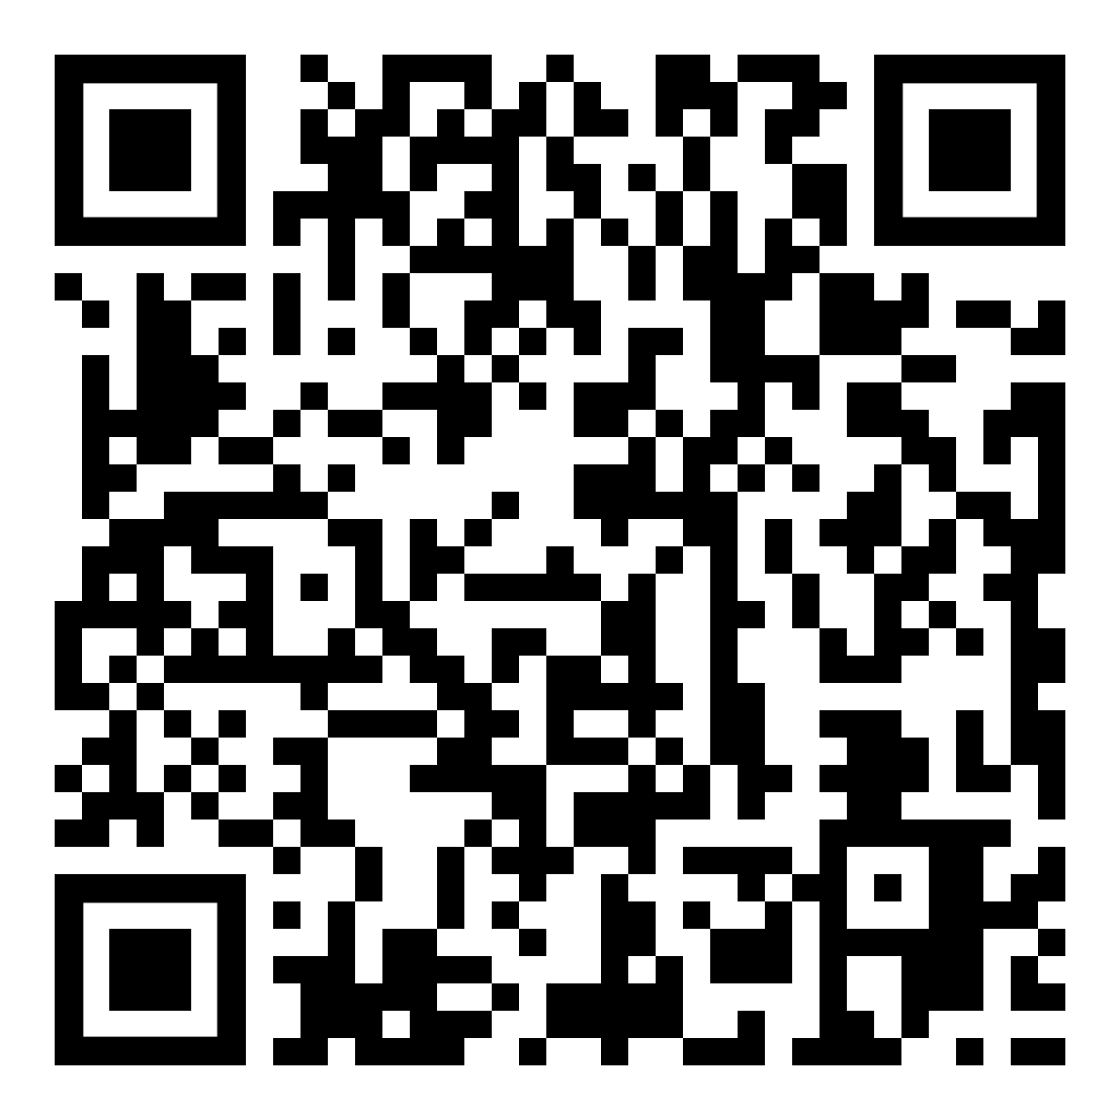
Summary Stats Recap
https://dorksquith.github.io/DataAnalysisTechniques/terminologyandconcepts/

Slide 51
Most Important Thing
https://dorksquith.github.io/DataAnalysisTechniques/
Get this working for your operating system.
Making sure everyone is on top of this will be the main focus of Wednesday’s workshop.
It is essential for all your assessed work (3 courseworks and software exercise)

Slide 52
Assessment Reminder
Three Coursework Submissions spread over term
Best two of three grades count to 30% of your grade for this module
Tasks will be available for at least 2 weeks ahead of the regular submission deadlines
Coursework Task 1 will be available this Wednesday before the workshop
I will announce on canvas
One Software Exercise submitted in the A1 exams period
Counts to 70% of your grade for this module

